Slide 1
Newton Labs Underwater Laser Scanning

Slide 2
In the beginning at MIT
Click to play video

Slide 3
Newton won the first two World Cups of Robotic Soccer/Football
Click to play video
All operation with Artificial Intelligence; no human intervention

Slide 4
Newton Engineering Capabilities
Mechanical Design Engineers
Industrial Backgrounds
Robotics & Material Handling
Design and Build
Prototyping
In House Machine Shop
3D Printing
Electrical Design Engineers
Integrated Software Functionality
Schematics
Custom Mother, Interface and Circuit Boards
Motor and LED Drivers
Power Supply
Control Box Design
Cabling

Slide 5
Newton Engineering Capabilities
Software Design Engineers
Computer Vision
Laser Scanning
Robotic Controls
User Interface Design
Technology Integration
ACFM, Alternating Field Current Measurement
Microcontroller firmware
PLC and industrial motor controller integration
3rd party sensor integration
Ultrasonic (UT) sensors

Slide 6
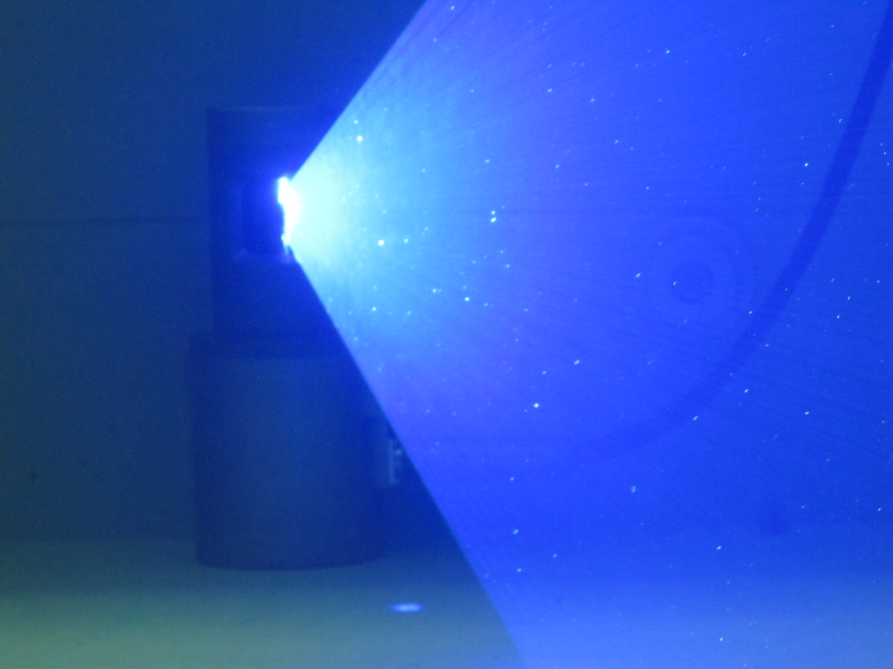
Newton Labs and Underwater Laser Scanners
Newton was the first to develop commercially available underwater laser scanning measurement technology.
Newton scanners were first deployed in 2008 and have been in use continuously since that time.
Newton is the oldest and largest manufacturer of Underwater Laser Scanners with far more systems deployed that any other underwater laser scanner manufacturer; long experience in properly capturing scans for accurate underwater measurement.
By far the largest and most complete line of underwater Laser scanners in the world,
All Newton underwater scanner models operate equally well in both air and underwater.
All Newton scanners provide a live camera view that makes operation easy; designed for use by operators, not engineers.

Slide 7
Easy to Operate
Newton Scanners are the easiest to use in the industry
Designed for use by operators; not engineers
Live Camera view to set up and watch the scan
Fully adjustable scan timing
Factory Calibrated-no field calibration required
Automatic settings- only in shallow water usage with sunlight is any change of setting required

Slide 8
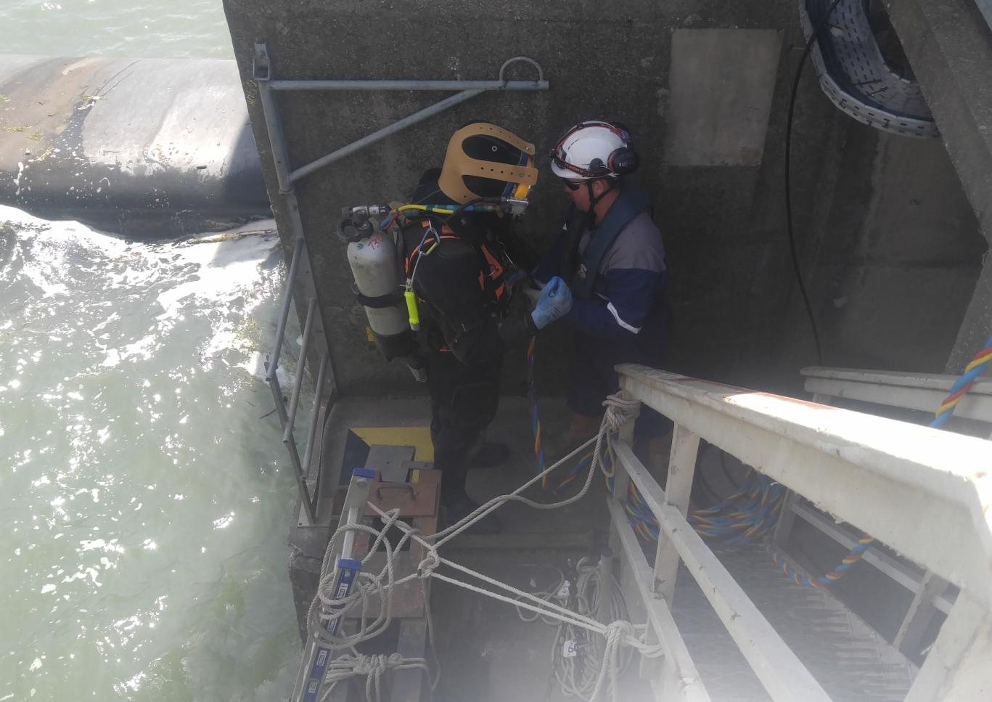
Field Proven Newton’s Underwater Scanners are in use in the US, Europe, Asia and Australia/New Zealand Some Examples of the usage of Newton’s Underwater Laser Scanners Subsea Structures Subsea Pipelines Subsea Flanges for spool measurement Marine Structures Pilings Bridge abutments Construction Structures Dam Inspection Ship Propellers without removal Ship Hulls Nuclear Service And Many Others

Slide 9
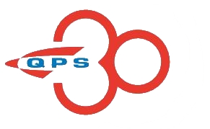
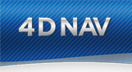
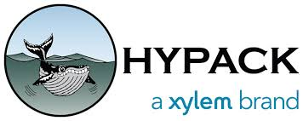
Newton Underwater Scanners Integrate with all IMU, MUX and AUV/ROV Integrates with the common Navigation Software: Outputs in virtually any format: Standard: LAS, xyz and .PLY. Other outputs available upon request Accepts 1PPS subsea-ZDA via Ethernet

Slide 10
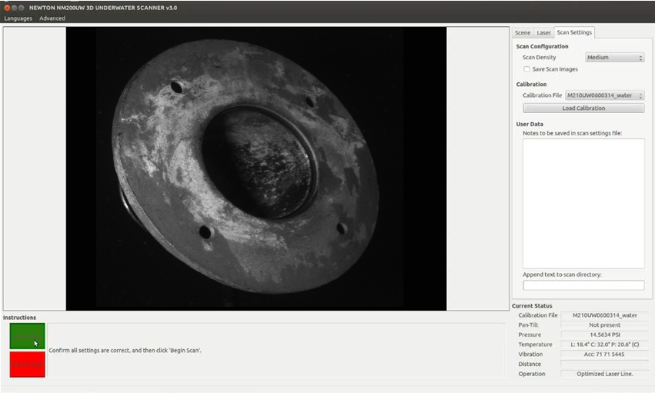
Live Camera View
All Newton underwater laser scanners are provides the operator with a live camera view
Easily locate the area to scan
Watch the scan take place on the screen
By far the simplest and easiest scanners to operate with its live camera view

Slide 11
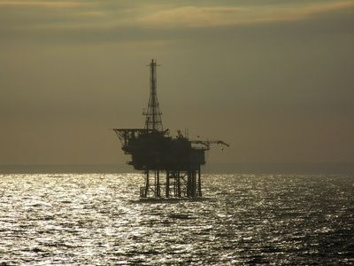
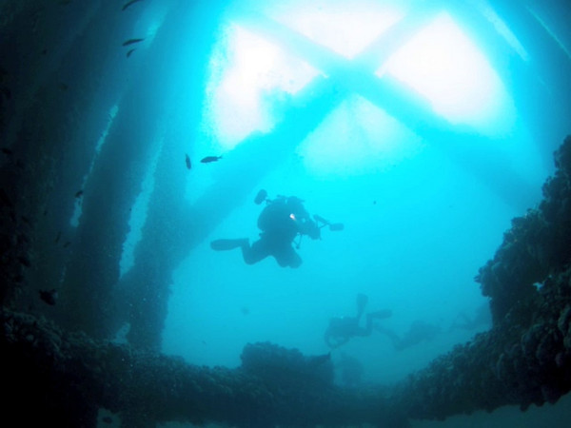
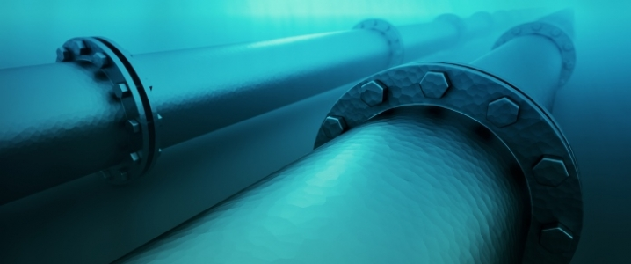
The Challenge
Hardware, piping and structures underwater begin to change over time which can affect their function and integrity.
Obtaining precise underwater measurements to track changes and degradation is generally difficult and in some cases, dangerous.
New Installations may need to have accurate as-built dimensional CAD models

Slide 12
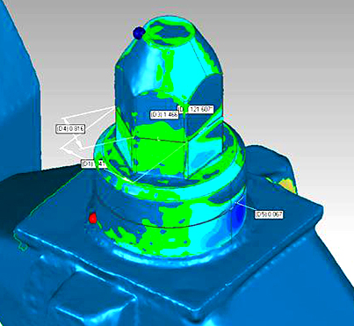
The Solution
Underwater laser scanner technology by Newton Labs captures as-built measurements with sub-millimeter precision, as well as being able to quantify rust, wear, fissures, corrosion, cracks, welds, pitting and other deformities.
Laser scanning produces a point cloud so dense that when utilized with industry standard 3D software a fully measurable CAD model of a scanned area can be generated with far higher resolution than other technologies such as ultrasound or photogrammetry.
This fully dimensioned CAD model of an underwater bolt was rendered in 3D software by combining point clouds from consecutive scans at different positions. Areas of greenish coloration indicate corrosion.

Slide 13
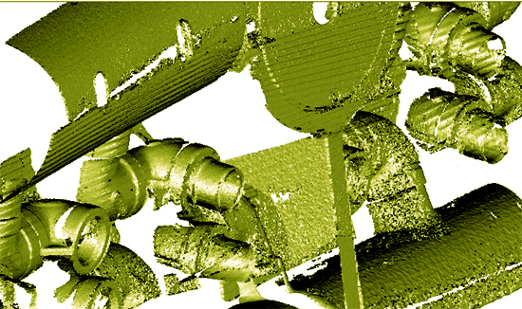
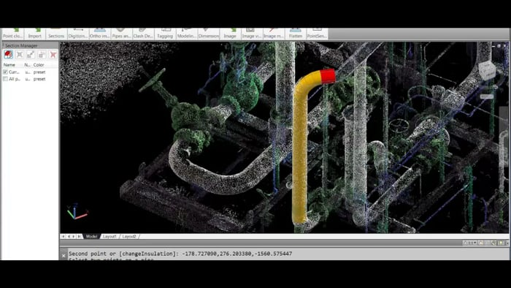
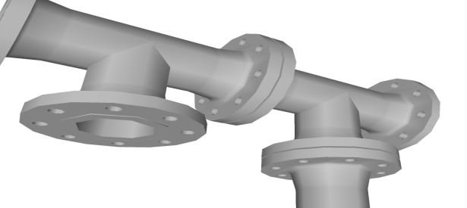
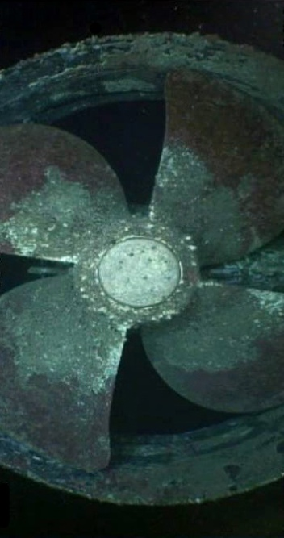
Accurate CAD Models from Point Clouds
Measurable CAD models can be developed from large underwater areas or surfaces by combining the point clouds of several scans.

Slide 14
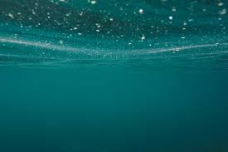
Newton’s Subsea and Marine Underwater Laser Scanning Models
For precise, non-contact dimensional underwater measurements and the production of as-built 3-D CAD models

Slide 15
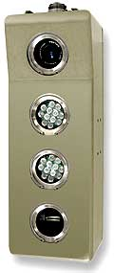
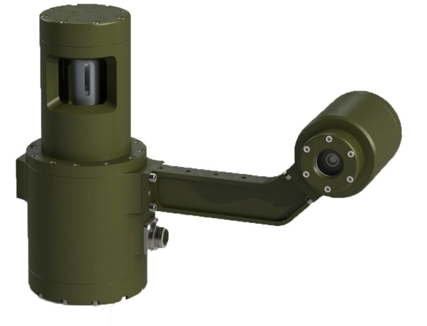
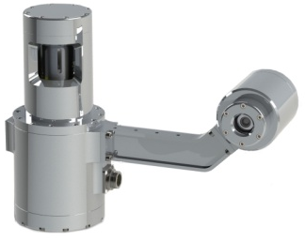
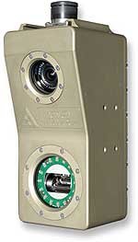
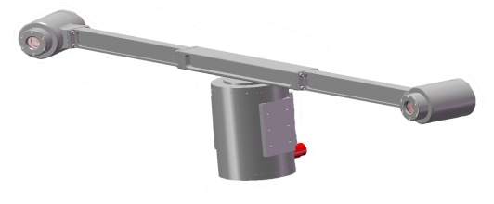
Newton’s Extensive Line of Subsea/Marine Laser Scanners The most comprehensive in the world
M210UW
1M Range
100M Depth
M310UW
5M Range
100M Depth
M500UW
1 M Range
500M Depth
M1500UW
5M Range
1500M Depth
M3200UW
5M Range
3200M Depth
M4000UW
5M Range
4000M Depth
PL3200UW
10M Range
3200M Depth
PL4000UW
10M Range
4000M Depth
TP4000UW
20M Range
4000M Depth

Slide 16
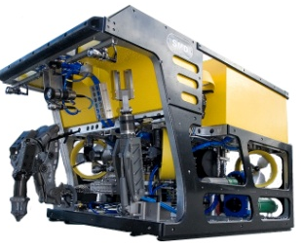
Internal and Fixed Line Scanning
There are three types of laser line scanners:
Internal Scanning models: The laser line is moved and controlled by internal encoders
Fixed line Scanning models: Uses IMU or ROV data for the laser line position; the laser line is fixed; not internally scanned
Tripod Mounted model for double the maximum range: to 20 Meters
Click to view
Internal Scanning
Fixed Line
ROV/AUV IMU
Data

Slide 17
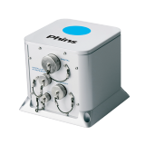
Newton’s Unique Dual Usage Scanners Internal scanning and Fixed Line scanning with the same Newton Underwater Laser Scanner models
Click to view
All Newton internal scanning models can also be used in Fixed Line mode with IMU input
Fewer scanners required for maximum coverage
ROV moving scans and then stop for detailed structure scans
Internal Scanning
Fixed Line IMU Data

Slide 18
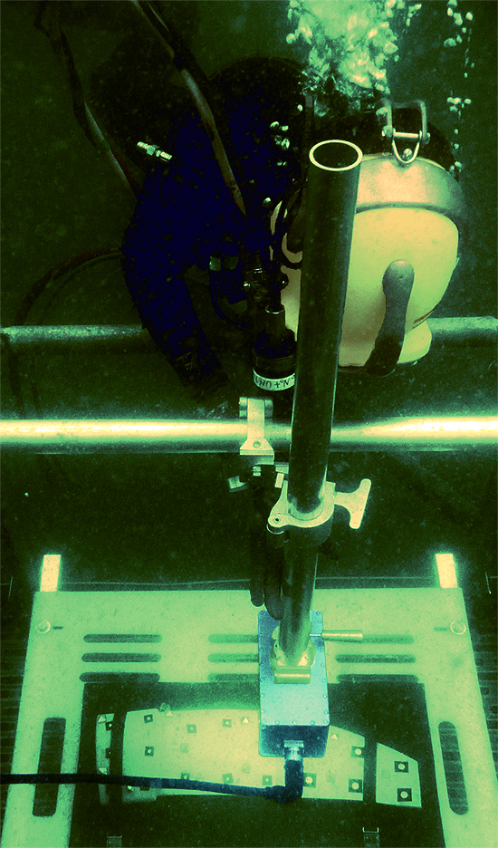
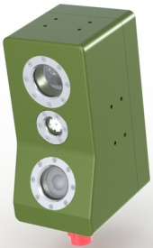
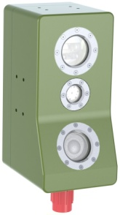
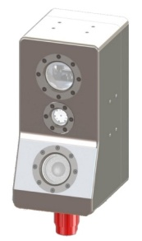
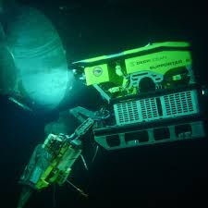
Short Range Scanners: Up to 1 meter range Extreme Accuracy Measurement
The short range M210UW, M500UW, HRM1500UW, HRM3200UW, and the HRM4000UW systems have an effective scanning distance of between 6 in. (150mm) and out to a distance of 3 ft. (0.9M) for a scan coverage area of 2.1 ft. x 2.9 ft. (64 cm x 88 cm).
Accuracy down to 0.02 mm
NM500UW
500 Meter
NM210UW
100 Meter
HRM1500UW
100 Meter
HRM3200UW
100 Meter
HRM4000UW
100 Meter

Slide 19
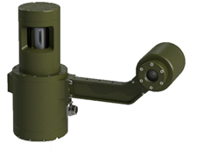
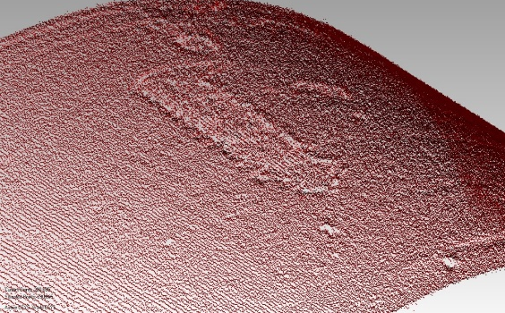
Medium Range Scanners: 5 meters Range High Accuracy Measurement: to 0.2 mm
M310UW
100 Meter
M1500UW
1500 Meter
M3200UW
3200 Meter
M4000UW
4000 Meter
Live camera view
Dual mode – Internal Scanning or Fixed Line
Scan data instantly viewable
Structure scanned with a M3200UW

Slide 20
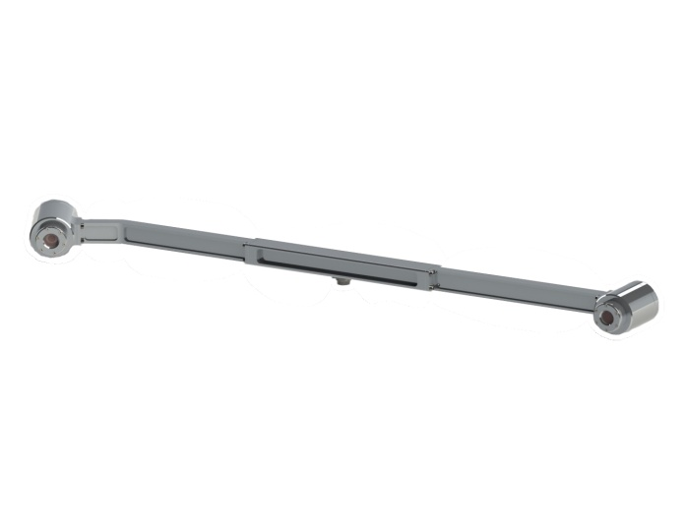
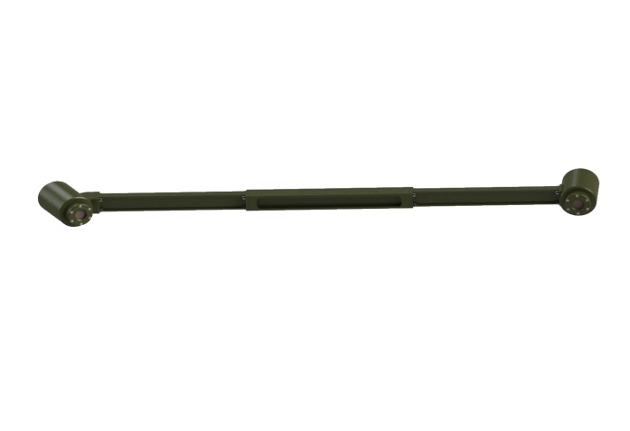
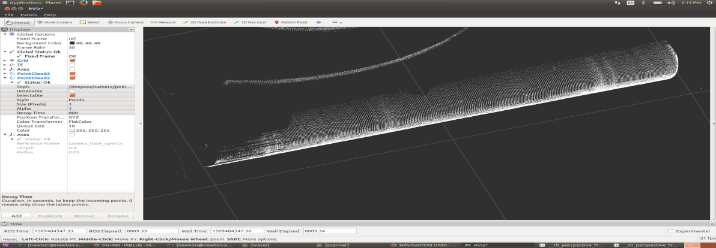
Long Range: to 10 Meters
Fixed Line Scanners
IMU or ROV Position Data
PL4000UW
4000 Meter
PL3200UW
3200 Meter
Pipeline scanned -fixed line with iXblue position data

Slide 21
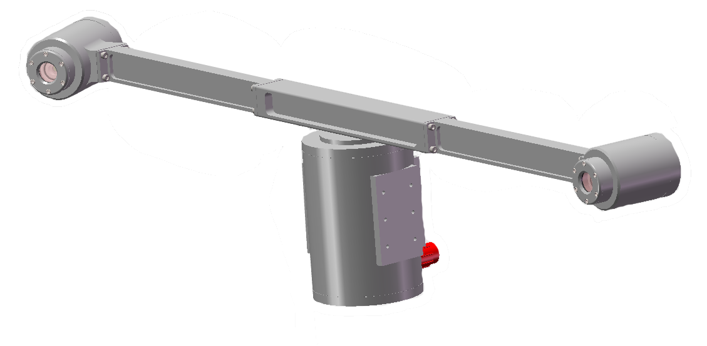
Longest Range: to 20 Meters
Tripod or Robot mounted with incorporated motor driven rotator
Utilizes slip ring communication with unlimited computer controlled rotation- no cable wrap-up
Live Camera View

Slide 22
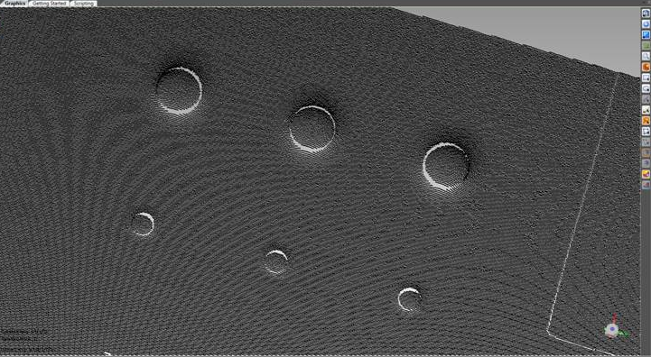
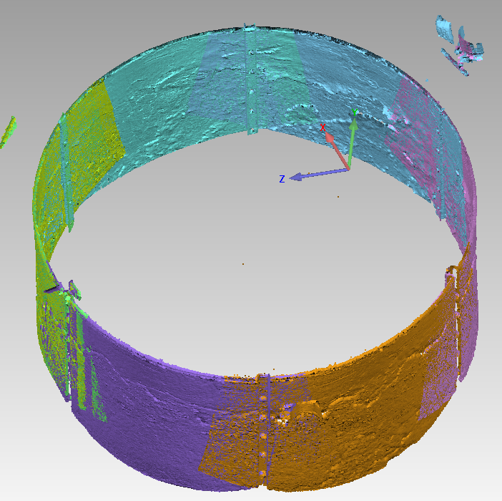
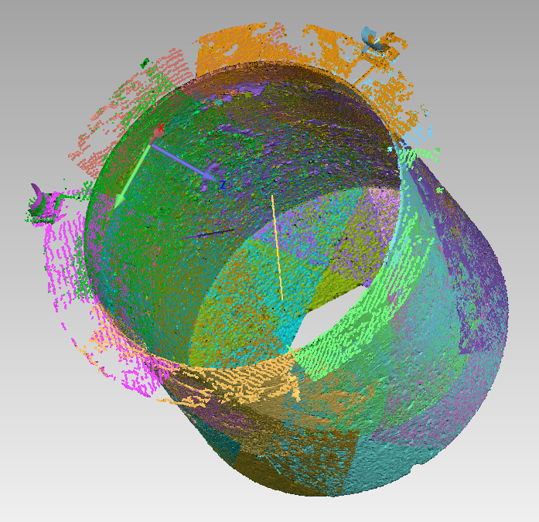
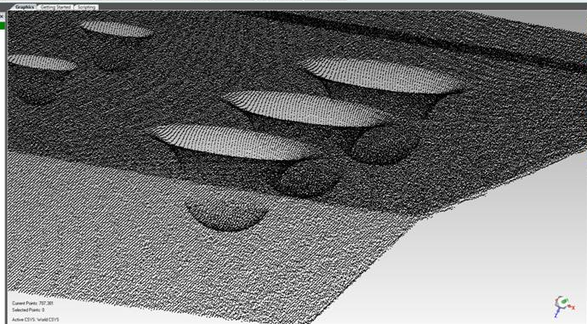
Point Cloud Output
Point Cloud output with hundreds of thousands of points
Stitch multiple point clouds together for complete 3D modeling
Internal Well Head

Slide 23
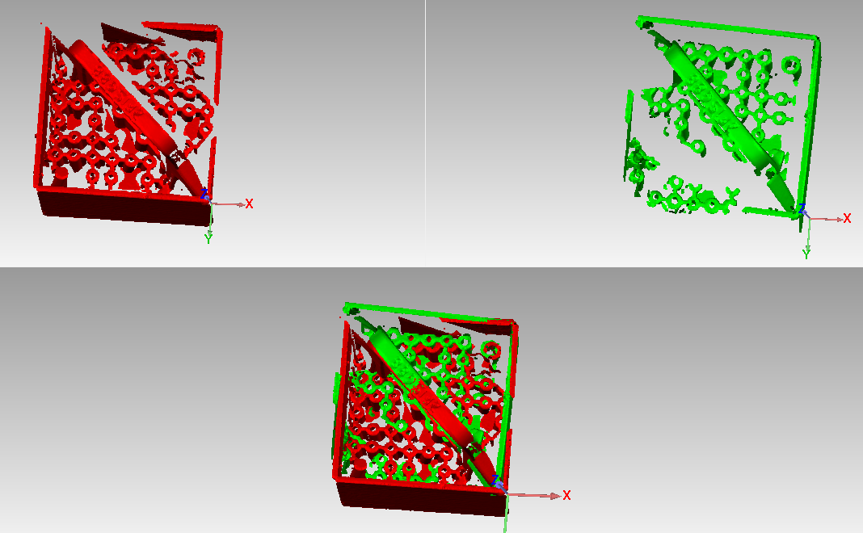
Converting Point Cloud to CAD
In post processing programs, scan data can be combined using manual registration (common feature detection) and global registration, aided by best fit analysis.
Manual Registration makes adjustments to the spacial position of scans based on user-defined pairs of corresponding points from each object. Similar points, such as the handle, or even smaller details, identify areas for the software to combine data from two or more scans.
Global Registration makes fine-tuned automatic adjustments to the spacial position of two scans on the basis of all points.

Slide 24
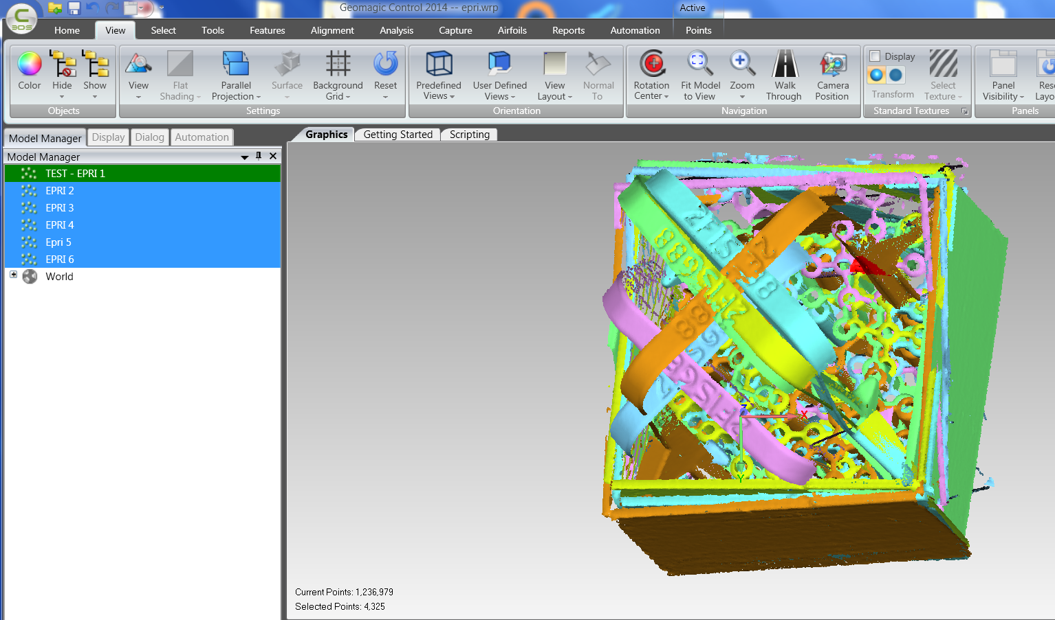
Converting Point Cloud to CAD
M210UW scan data imported into GeoMagic 3rd Party software program
Multiple point cloud files can be loaded in order to combine scan data taken from multiple angles/positions.
At right, data from six point cloud files all imported into GeoMagic.

Slide 25
Converting Point Cloud to CAD
Best fit alignment can be used to show deviations of the scan data versus nominal dimensions.
A color map, as shown at left, is used to reflect these deviations.
Measurements can be taken in modeling software and fully exported as .stp file into CAD programs.

Slide 26
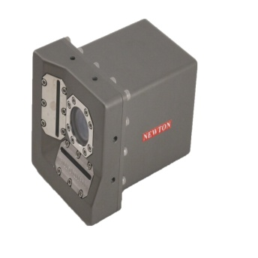
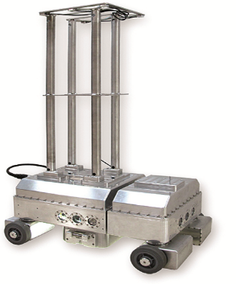
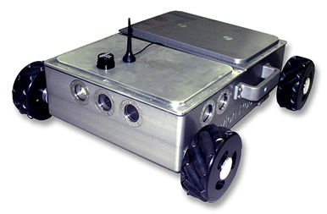
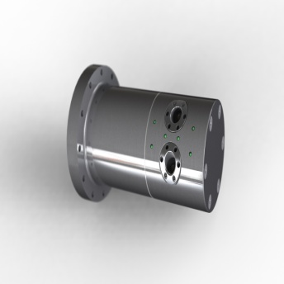
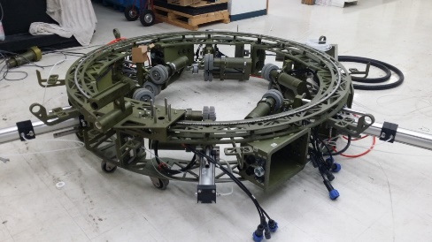
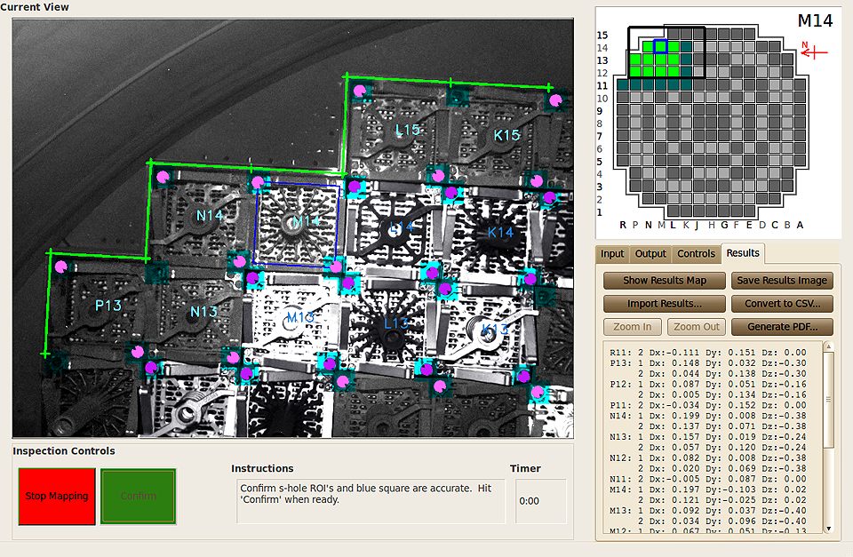
Some Other Newton Underwater Products
Angle and Distance Sensor
Inspector Robot
Surveyor Robot
Pipe ID Laser Scanner
Machine Vision Location and Verification Systems
Pipe ID Inspection Robot
Leg/Piling Inspection Robot

Slide 27
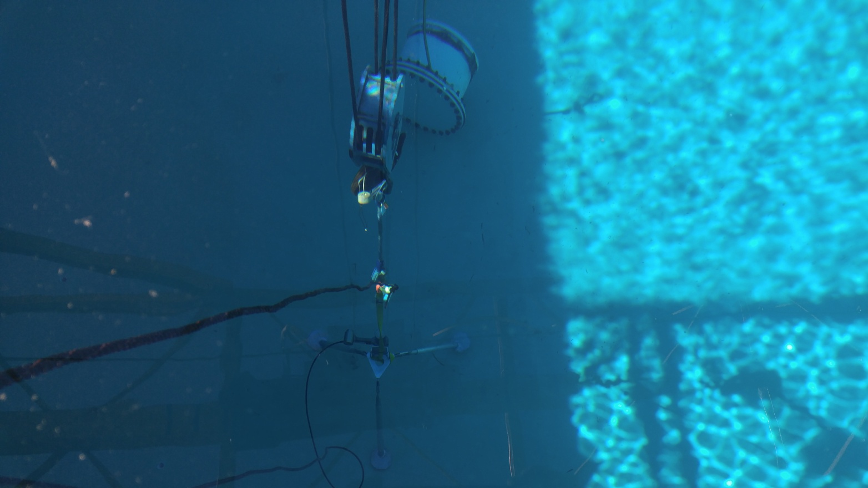
Subsea/Marine distance and angle measurement
Available in different models for depths to 4000 meters and ranges to 20 meters

Slide 28
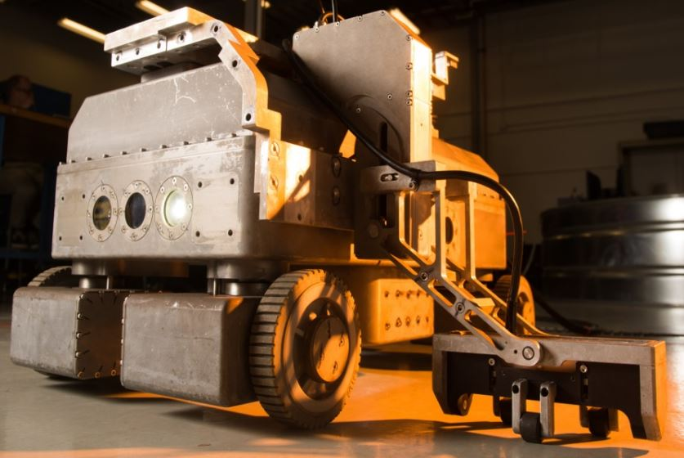
Underwater Inspection Robot
Used to inspect water storage tanks without draining the tank.
Deployable through a 20” manway(left)
4 wheel pods allow for movement in any direction under computer control
Equipped with down facing Underwater Laser Scanner, 4 side facing cameras and laser scanners; carries Phased Array Ultrasonic, Eddy Current and other instrument packages
Newton designed Global Positioning Optical System locates robot to within 1/8” on the tank floor, indexing location with inspection flaws.
Different tower highs available to render the location system visible in occluded regions

Slide 29
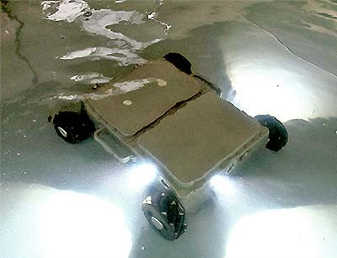
Surveyor Underwater/Air Robot Designed to carry many different sensor packages Load Carrying for third party equipment

Slide 30
Machine Vision Location and Verification Systems
Computer Vision camera that has revolutionized Underwater Location and Verification
Identifies unique assembly features through turbulence
Allows precise positioning of AUV/ROV for recharge and other location requirements
Replaces traditional measurements
Available in both mono and stereo versions

Slide 31
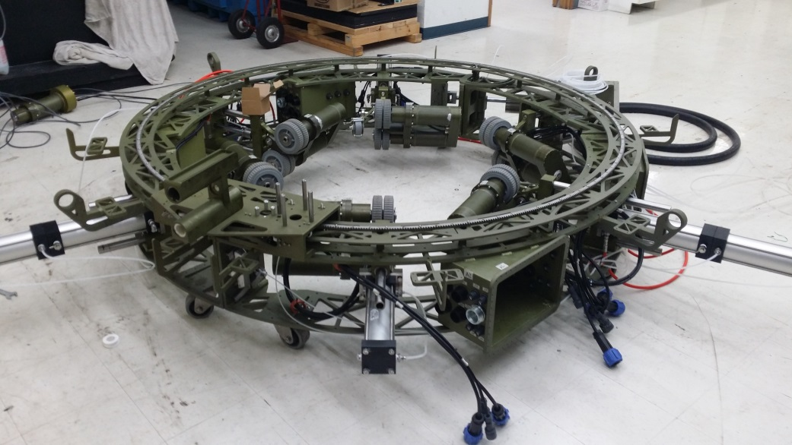
Piling/Leg Inspection Robot
Exterior climbing robot for the inspection of marine pilings
Available to inspect 0.8 to 4 meter piling.
Modular for shipping, repair and maintenance.
Clamps onto pile with one ton net force using pneumatics
Passive hydraulic system for automatic centering
Combines Newton Underwater Laser Scanning, Phased Array Ultrasonic and Optical inspection data into a single user interface
Climbs and Dives to inspect a 35 meter piling in air and underwater.
Uses data from ten encoders for balance, vertical positioning, tilt and sensor location.

Slide 32
Internal Pipe Scanners
Available for pipes from 3” to 96”

Slide 33
Robotic ID Pipe Inspection- Air and Underwater
Three different adjustable sized robots to operate inside offshore drill risers ranging in size between 3” and 31.5”
Modular design for easy maintenance and field repair.
Combines Newton developed Underwater Laser Scanning and other sensors such as Phased Array UT, ACFM and Eddy Current measurement inspection technologies with optical imaging to inspect pipeline integrity

Slide 34
Contact Information
Newton Labs
441 SW 41st Street
Renton, WA 98057 USA
Tel: 425.251.9600
Sales
sales@newtonlabs.com
www.newtonlabs.com

